Slide 1
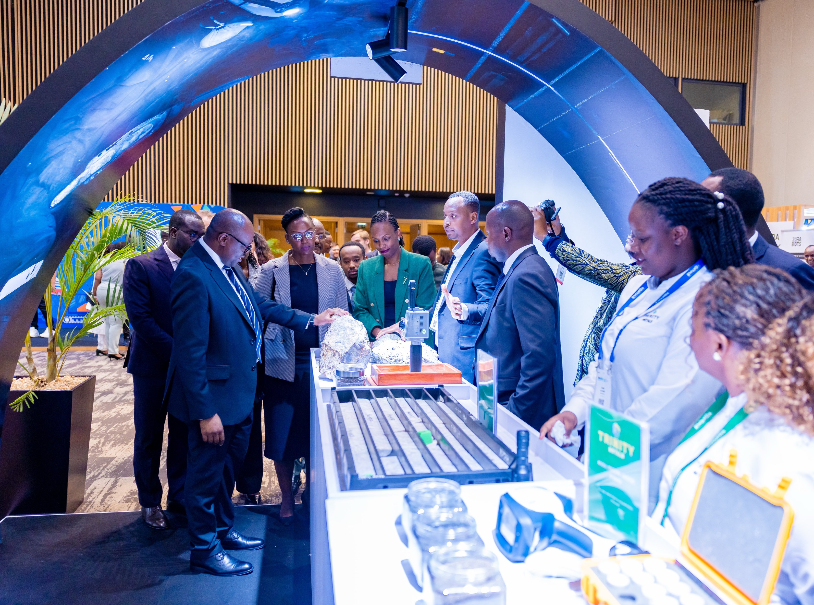

Mineral Export Performance and Projection for the year 2026-2030
11 February, 2026

Slide 2
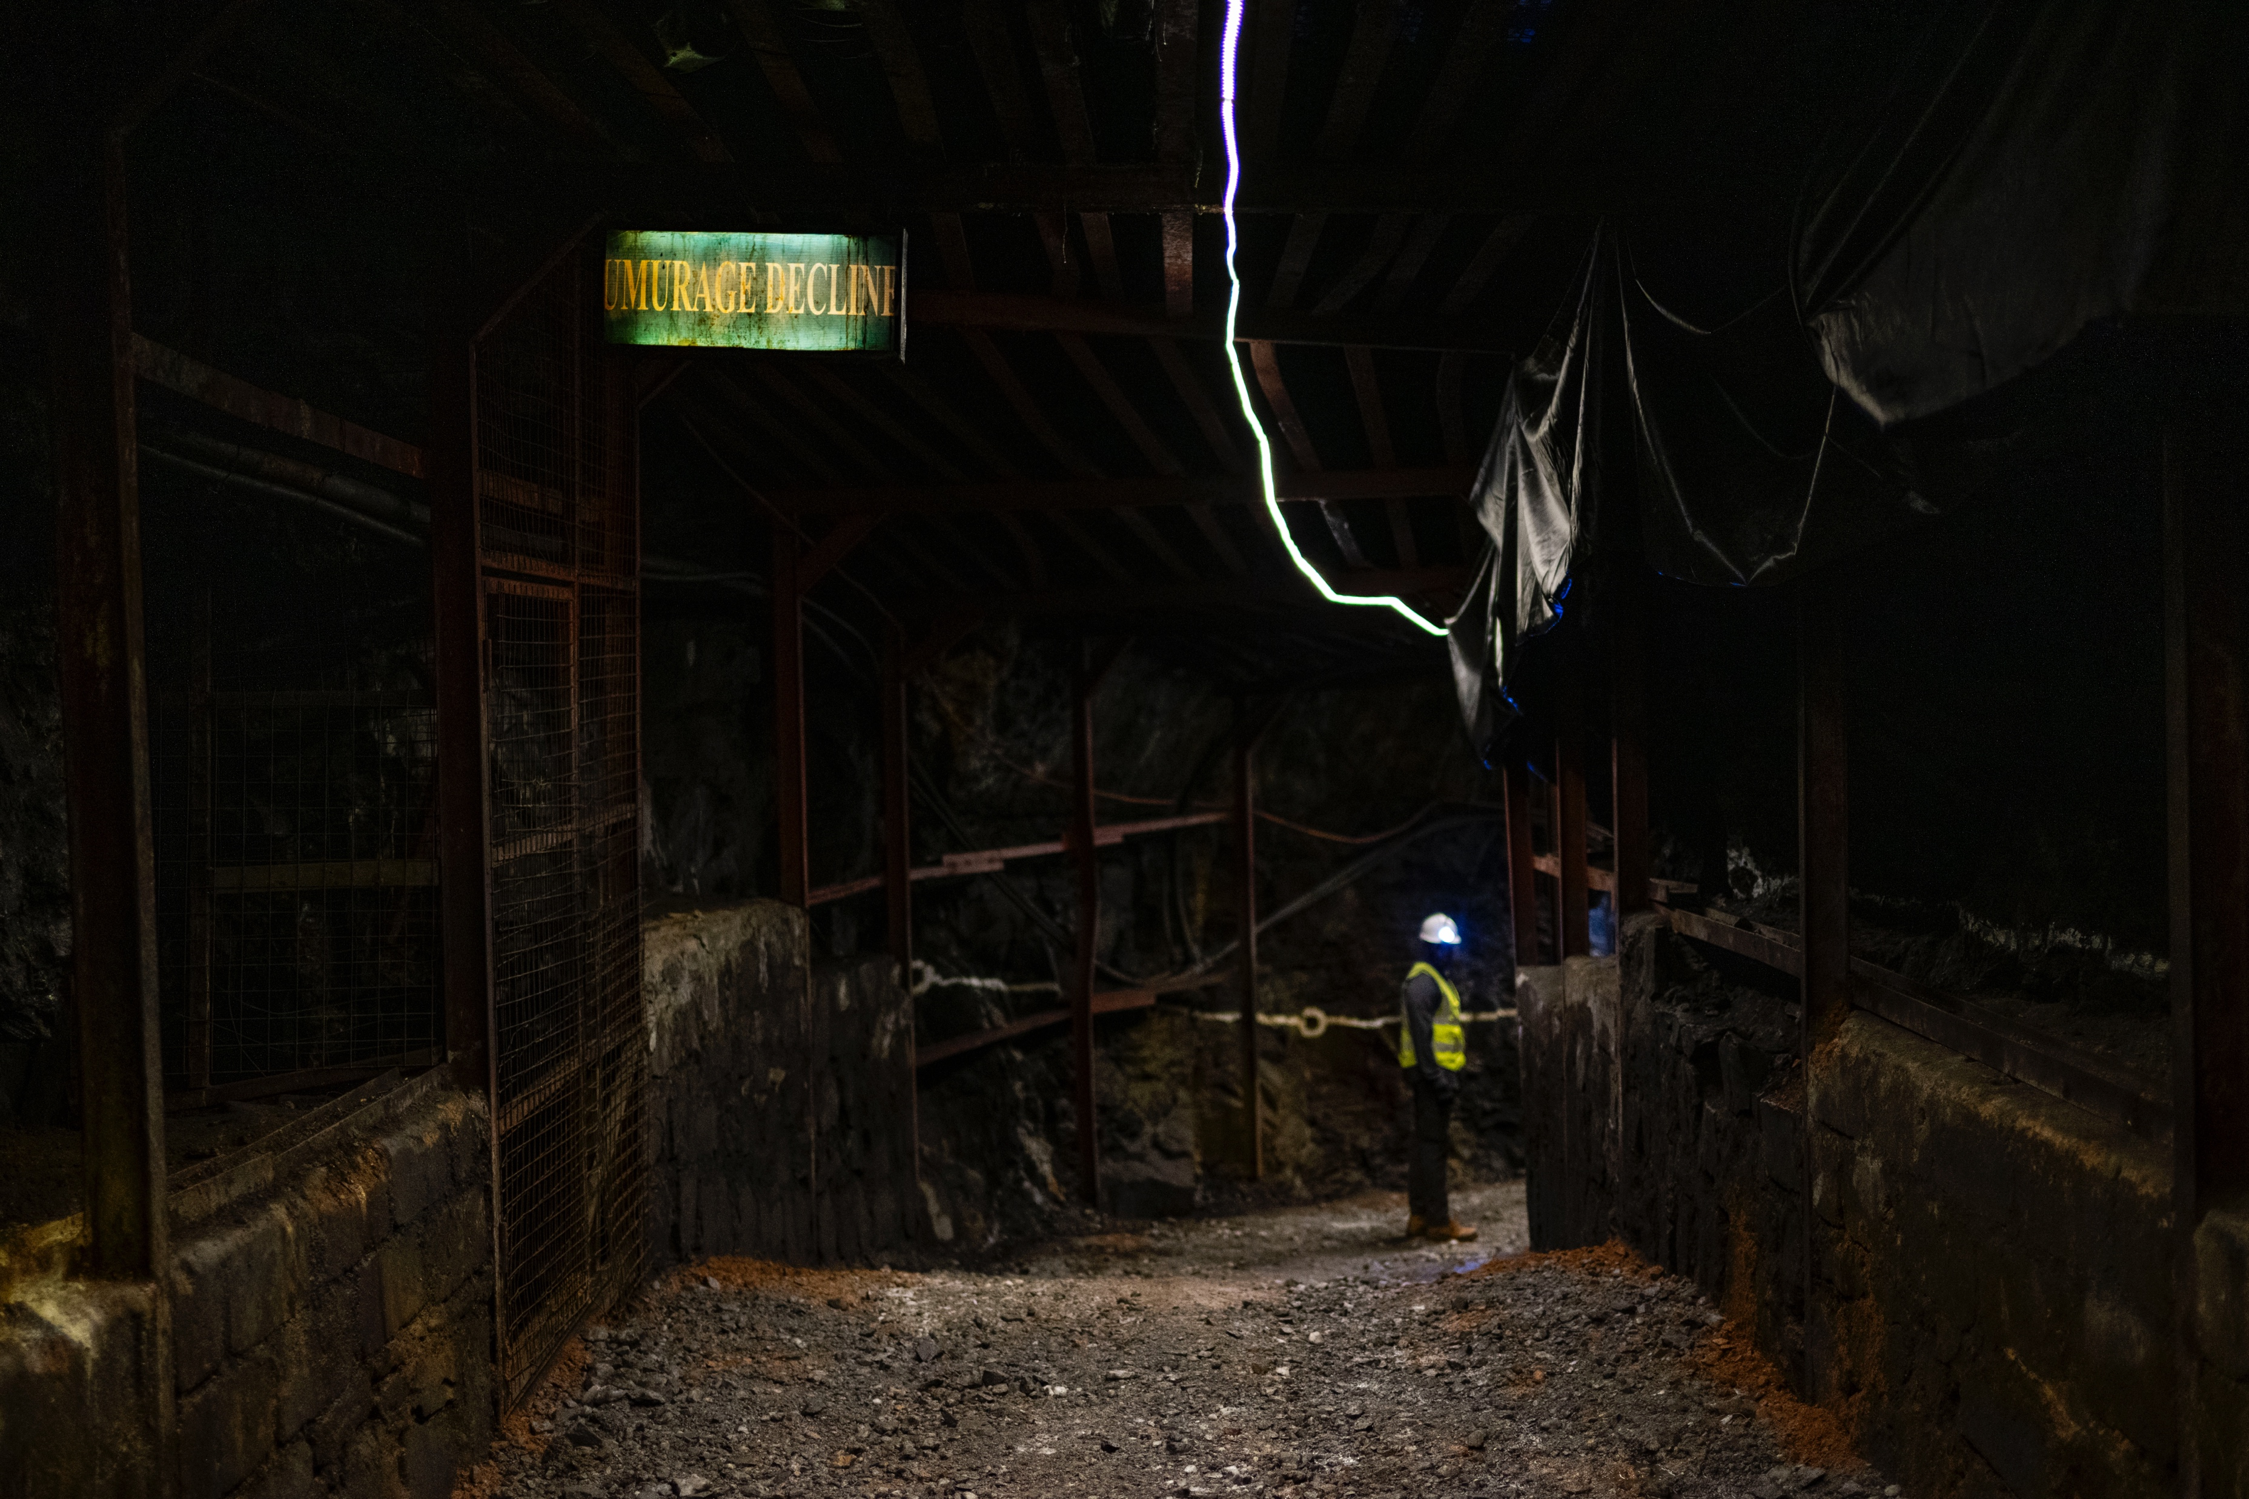
2025 Mineral Exports :Overview
2025 mineral exports showed mixed results
Gold exports declined due to reduced production and operational constraints
Base & industrial minerals surged, supported by expanded capacity, global demand, and better market access
Overall impact offset: growth in other minerals stabilized export volumes and foreign exchange earnings despite gold downturn

Slide 3
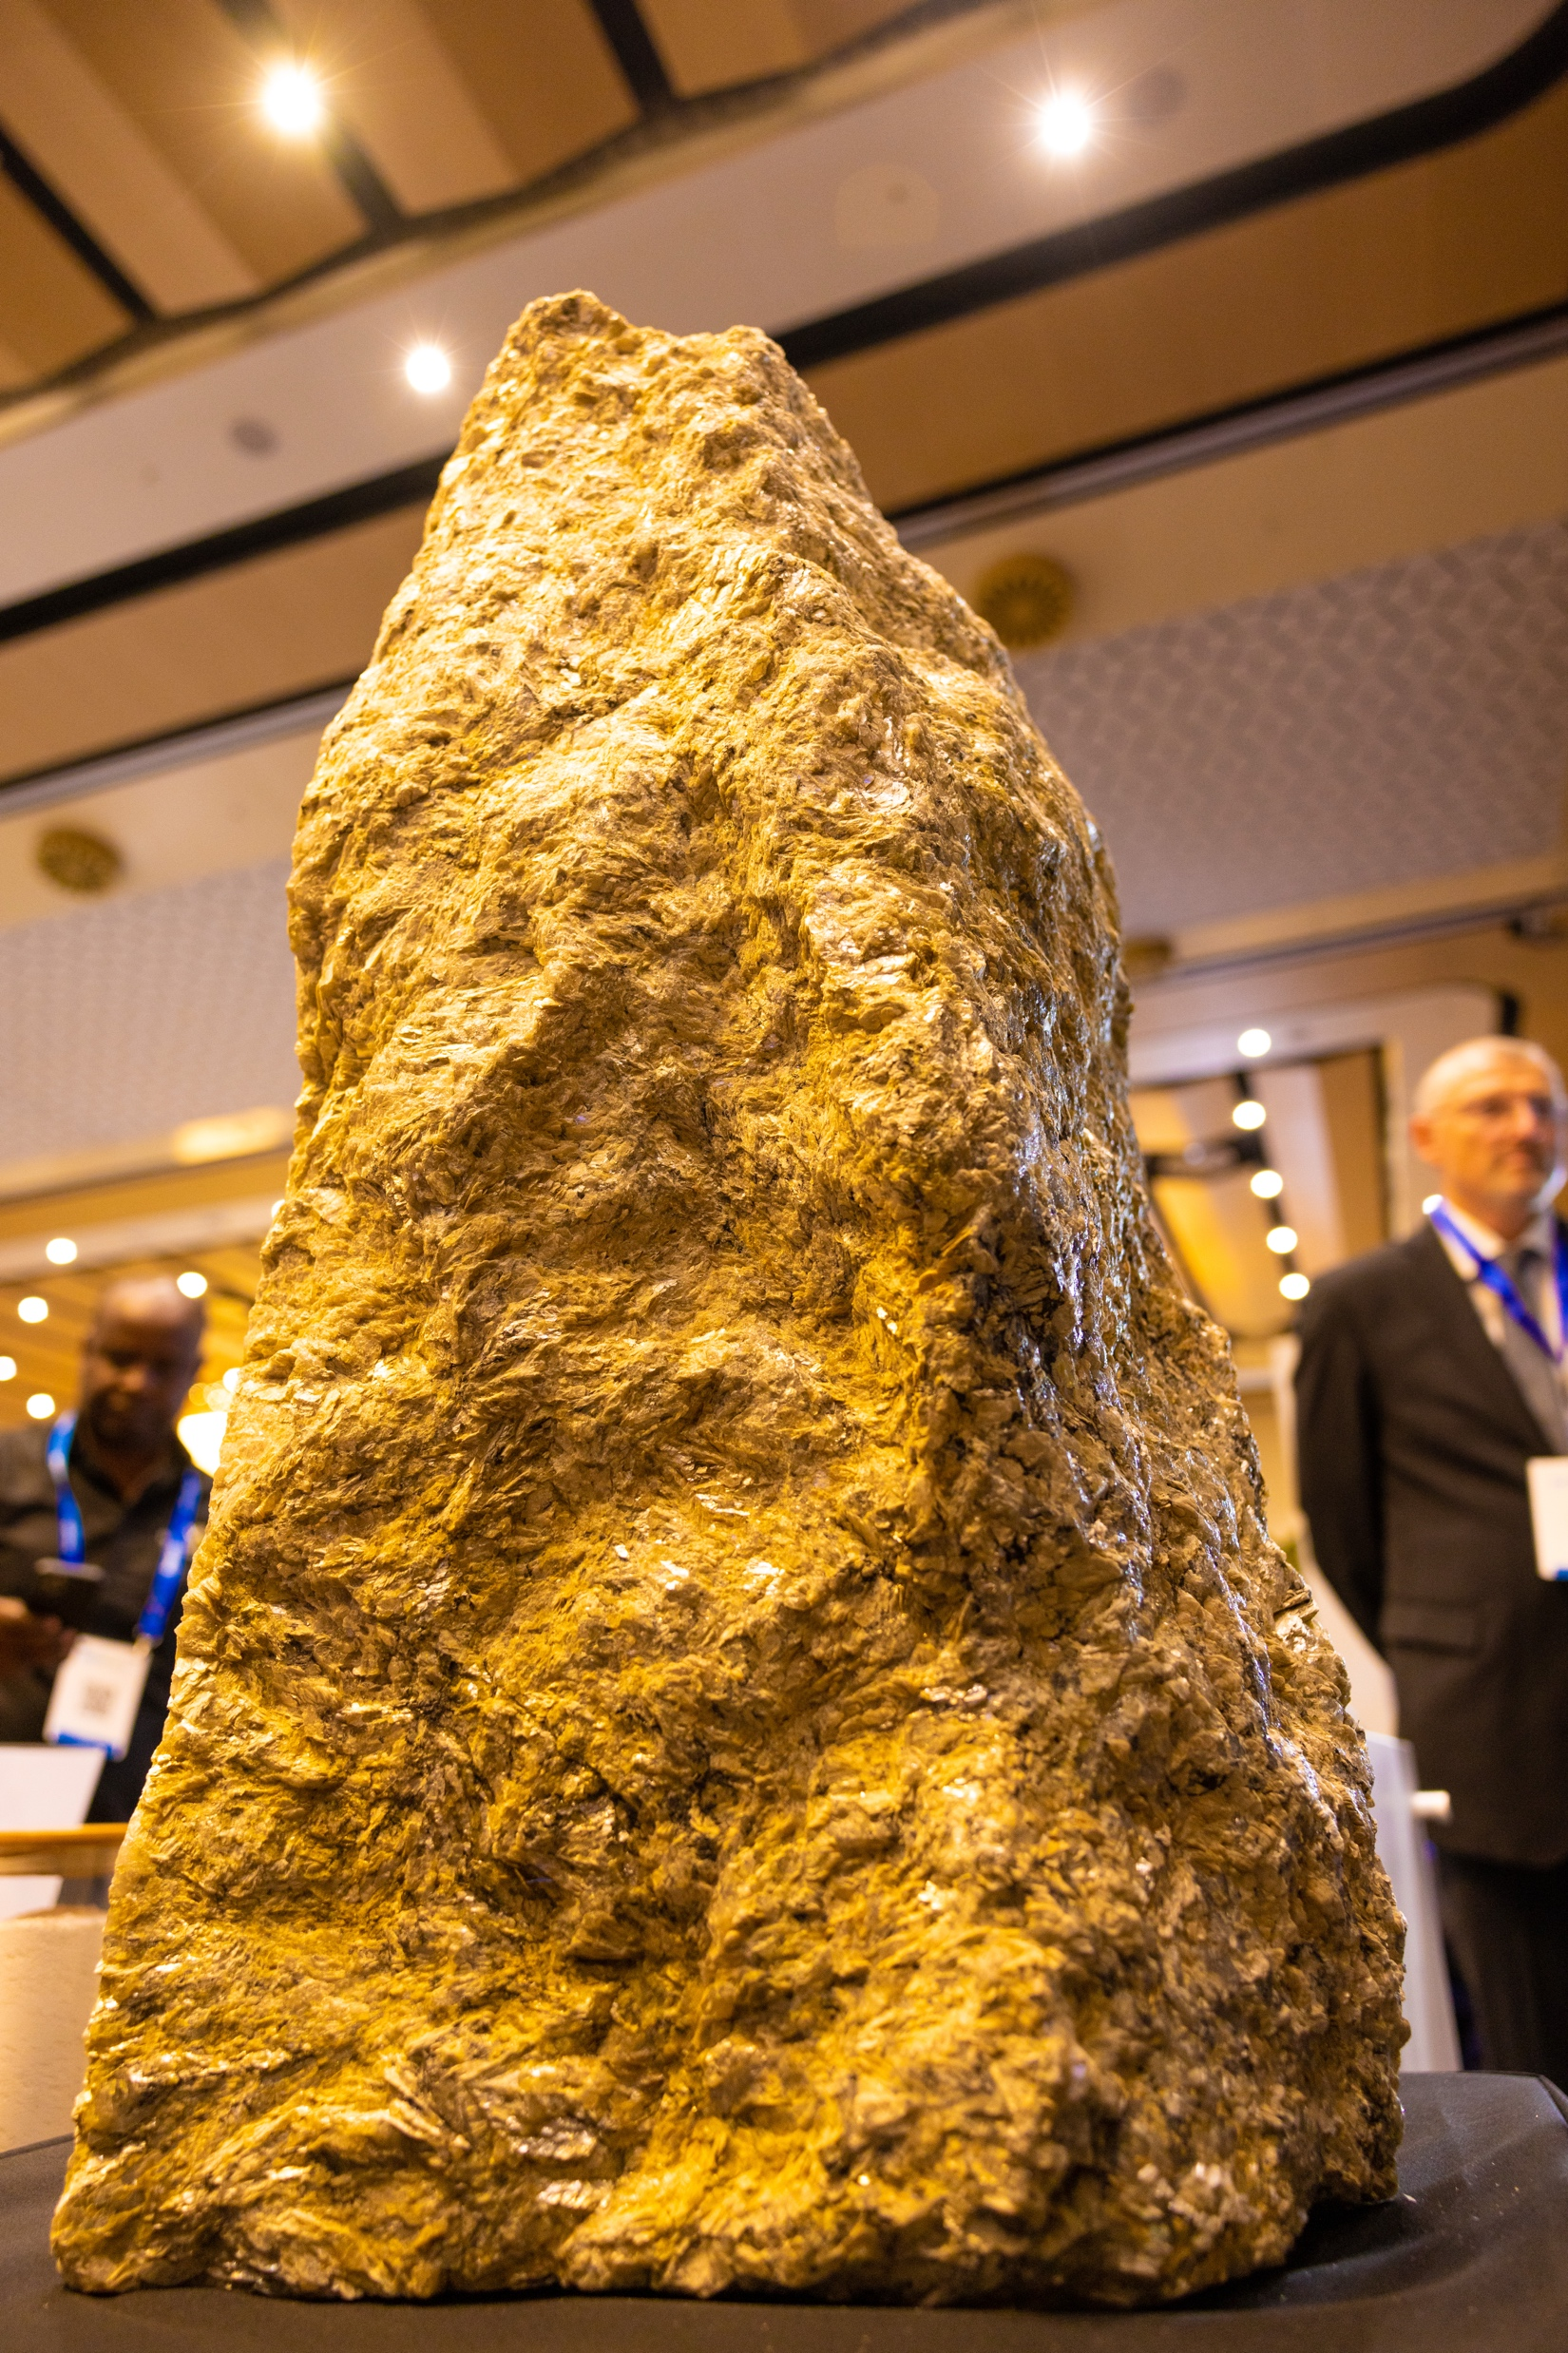
2025 mineral sector performance showed growing diversification
Reduced reliance on gold strengthened resilience
Broader export base enhanced contribution to economic growth
The table below summarizes mineral export data for the year 2025:
Commodities | Volume | Values
Cassiterite raw | 6,348,991 | 98,424,176
Cassiterite Processed | 1,340,613 | 44,655,250
Coltan | 2,743,017 | 129,987,223
Wolfram | 3,009,371 | 65,160,482
Gold | 6,327 | 516,799,384
Other minerals | 8,818,402 | 14,662,561

Slide 4
Comparative Analysis of Mineral Exports: 2024 vs. 2025
VOLUMES IN KG
COMMODITIES | 2024 | 2025 | VARIATIONS
CASSITERITE | 4,861,494.10 | 7,689,603.44 | 58.2
COLTAN | 2,383,911.10 | 2,743,016.54 | 15.1
WOLFRAM | 2,741,284.30 | 3,009,371.32 | 9.8
GOLD | 19,397.00 | 6,327.11 | -67.4
OTHER MINERALS | 26,973,940.30 | 8,818,401.93 | -67.3
Cassiterite & coltan gains from higher output via value‑addition and technology
Wolfram earnings up mainly due to rising international prices, not volumes
Gold exports declined
Other minerals increased largely on stronger global price levels
VALUES IN USD
COMMODITIES | 2024 | 2025 | VARIATIONS
CASSITERITE | 96,411,773 | 143,079,426 | 48.4
COLTAN | 99,166,346 | 129,987,223 | 31.1
WOLFRAM | 35,769,945 | 65,160,482 | 82.2
GOLD | 1,509,053,729 | 516,799,384 | -65.8
OTHER MINERALS | 14,579,085 | 14,662,561 | 0.6

Slide 5
Key Export Markets – 2025
2025 mineral exports diversified across global markets
Key destinations: Asia (China, UAE/Dubai), Europe, Africa, North America
Asia & UAE: Leading demand for strategic minerals in manufacturing & tech
Europe: Strong interest in industrial & green‑energy minerals
Africa: Regional trade expanded via integration & logistics improvements
Diversification strengthened resilience, reducing reliance on single markets and opening long‑term growth opportunities.

Slide 6
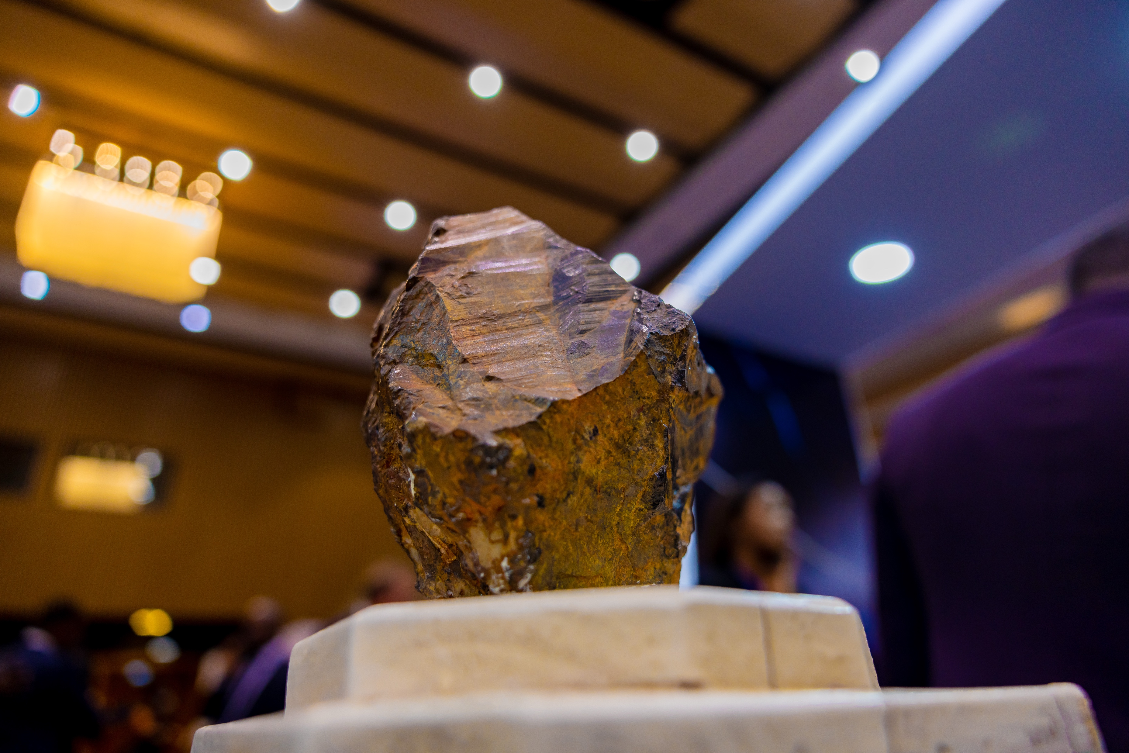
MINERAL EXPORT PROJECTIONS (2026–2030)
COMMODITIES | VOLUME IN KG
 | 2025 | 2026 | 2027 | 2028 | 2029 | 2030
Cassiterite raw | 6,348,991 | 6,729,930.28 | 7,133,726.10 | 7,561,749.66 | 8,015,454.64 | 8,496,381.92
Cassiterite Processed | 1,340,613 | 1,421,049.37 | 1,506,312.33 | 1,596,691.07 | 1,692,492.53 | 1,794,042.08
Coltan | 2,743,017 | 2,852,737.20 | 2,966,846.69 | 3,085,520.56 | 3,208,941.38 | 3,337,299.03
Wolfram | 3,009,371 | 3,099,652.46 | 3,192,642.03 | 3,288,421.29 | 3,387,073.93 | 3,488,686.15
Gold | 6,327 | 6,959.82 | 7,655.80 | 8,421.38 | 9,263.52 | 10,189.87
Other minerals | 8,818,402 | 8,994,769.97 | 9,174,665.37 | 9,358,158.68 | 9,545,321.85 | 9,736,228.29
COMMODITIES | PRICE IN USD
 | 2025 | 2026 | 2027 | 2028 | 2029 | 2030
Cassiterite raw | 15.5 | 15.8 | 16.1 | 16.5 | 16.8 | 17.1
Cassiterite Processed | 33.3 | 34.3 | 35.3 | 36.4 | 37.5 | 38.6
Coltan | 47.4 | 48.3 | 49.3 | 50.3 | 51.3 | 52.3
Wolfram | 21.7 | 22.3 | 23.0 | 23.7 | 24.4 | 25.1
Gold | 81,693.1 | 86,594.7 | 91,790.3 | 97,297.8 | 103,135.6 | 109,323.8
Other minerals | 1.6 | 1.6 | 1.6 | 1.6 | 1.7 | 1.7

Slide 7
Strategic Opportunities (2026–2030)
Value addition and mineral beneficiation
Expansion into new global markets
Increased participation in regional and global value chains

Slide 8
CHALLENGES AND INTERVENTIONS
Key challenges:
Price volatility in international markets
Inadequate infrastructure (transport, power, ports)
High cost of production
Environmental and social compliance requirements
Limited value addition and beneficiation
Limited access to affordable financing
Skills gaps in the mining workforce

Slide 9
Cont’d
Proposed interventions:
Strengthening policy and regulatory frameworks
Investing in mining-support infrastructure
Promoting mineral value addition and processing
Enhancing access to finance for mining projects
Supporting skills development and technology transfer

Slide 10
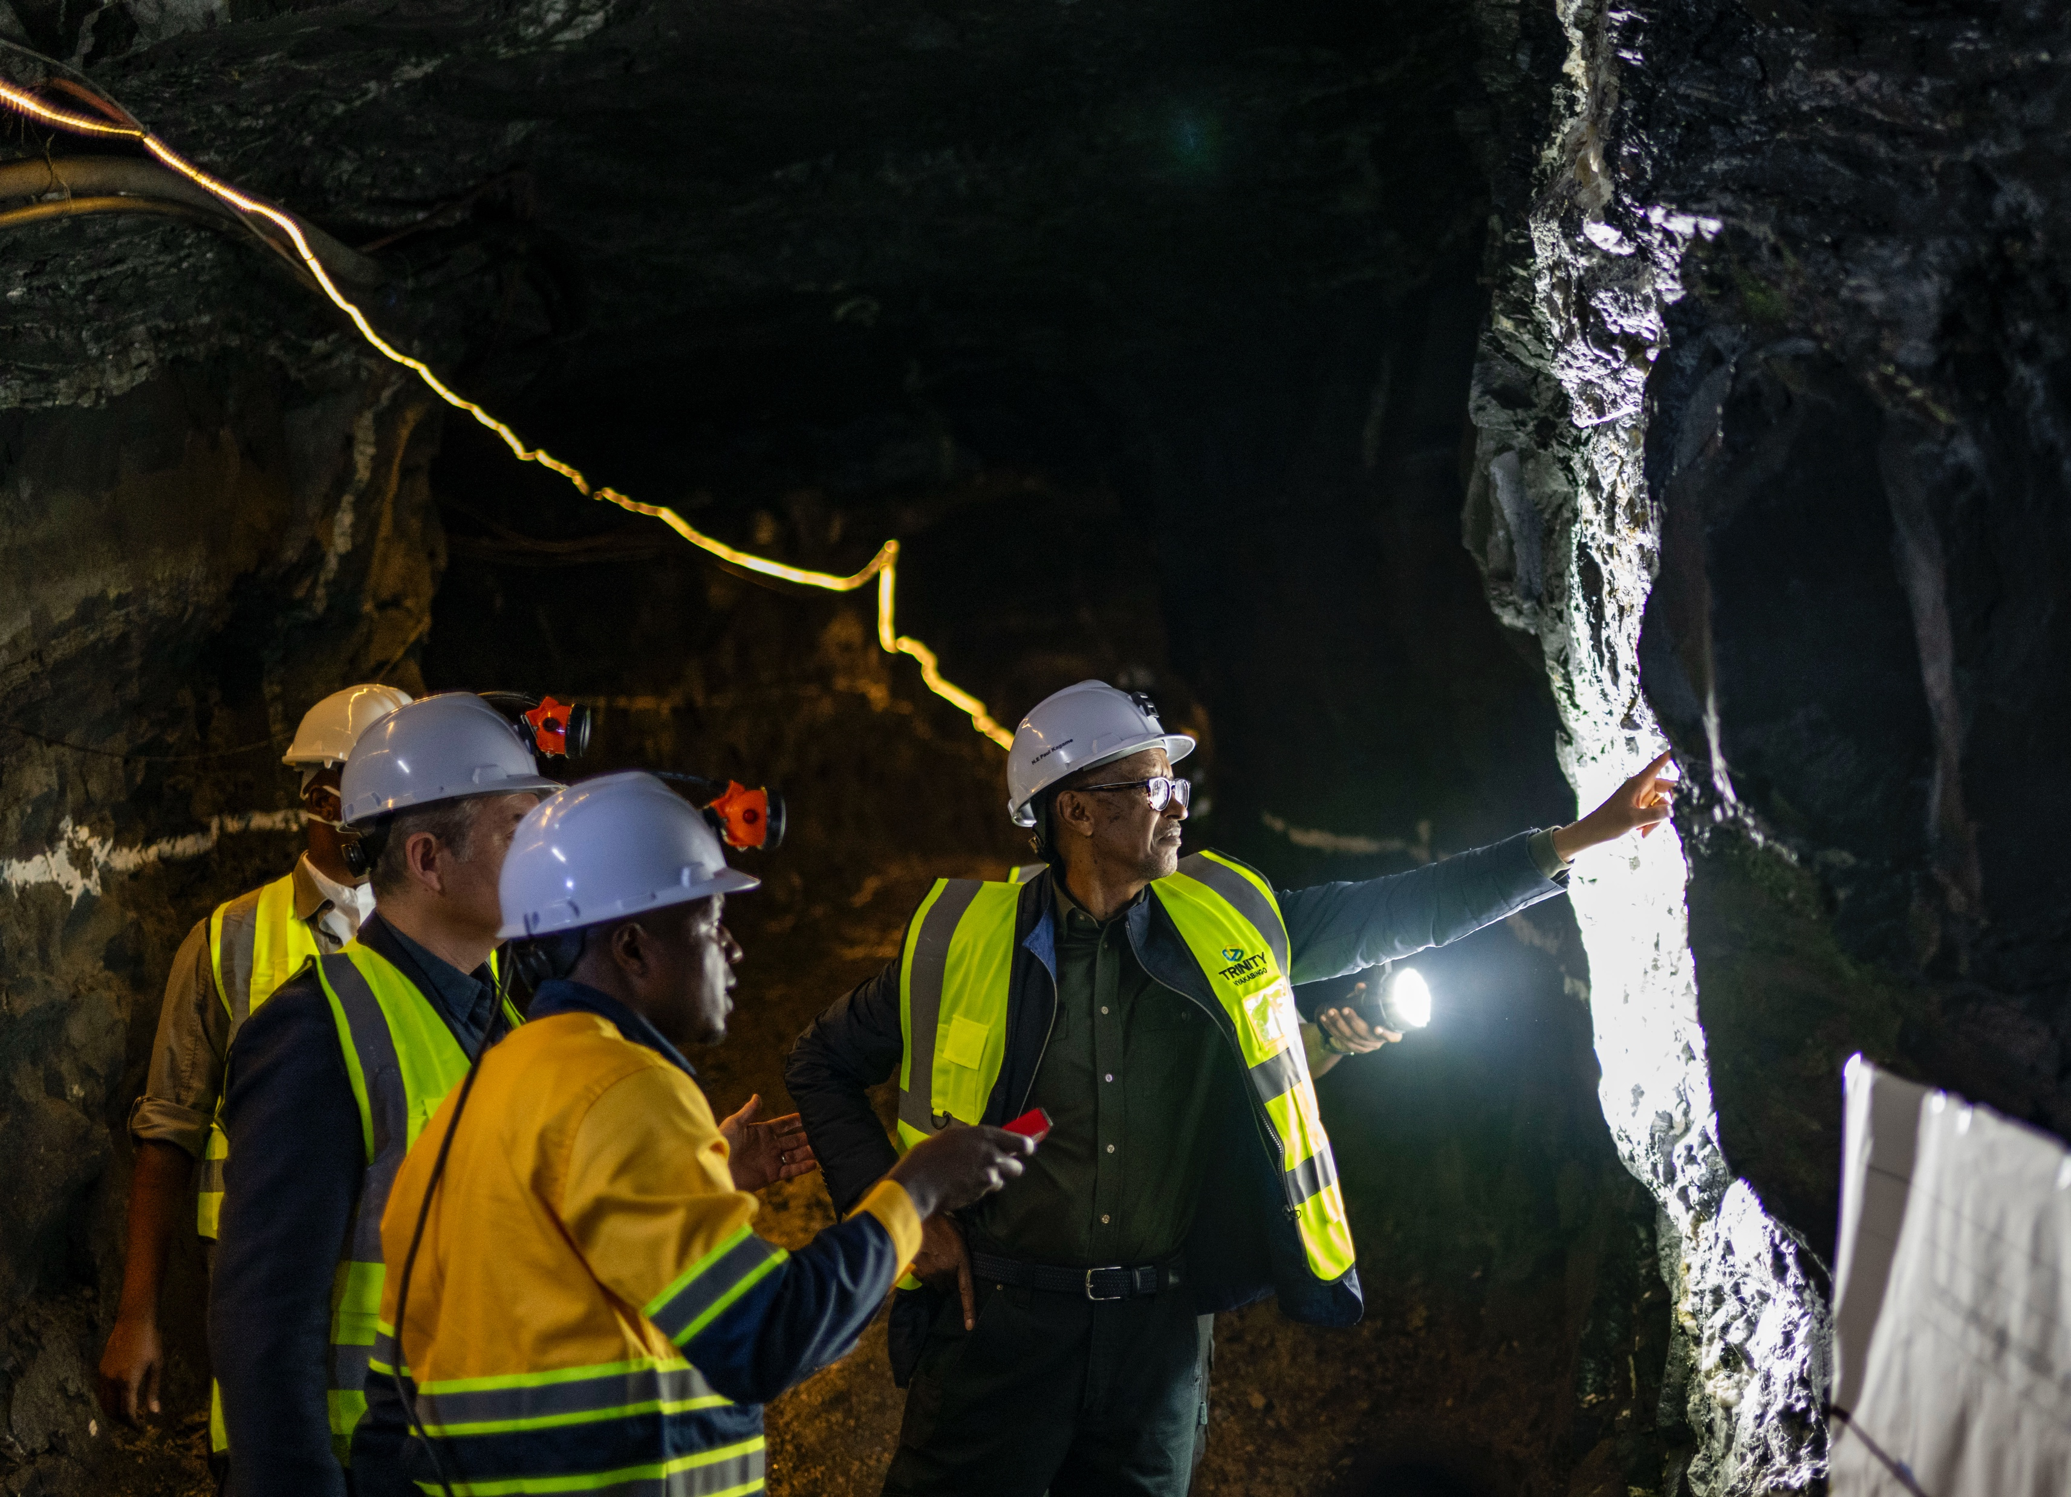
Conclusion
2025 demonstrated strong performance in mineral exports
2026–2030 outlook remains positive, driven by global demand
Addressing key challenges through targeted interventions will:
Enhance competitiveness;
Maximize export earnings;
Ensure sustainable sector growth.

